Slide 1

Medical Cost Prediction
(Healthcare Domain)

Slide 2
About me
My Self Tella Krishna Prasad, I had Completed my Bachelors of science in Electronic.
I want to upgrade myself with the new technology, Data science offers high demand, high salaries, and diverse opportunities across industries. It provides intellectually stimulating work with a significant impact, continuous growth potential, and the flexibility of remote work, making it a future-proof and rewarding career choice.
I am fresher with lot of Domain Knowledge.
GitHub Url : krishnaprasadtella/EDA (github.com)

Slide 3
Agenda (This should be the PPT flow)
Business Problem and Use case domain understanding(If Required)
Objective of the Project
Web Scraping – Details (Websites, Processor you followed)
Summary of the Data
Exploratory Data Analysis:
Data Cleaning Steps
Data Manipulation Steps
Univariate Analysis Steps
Bivariate Analysis Steps
Key Business Question
Conclusion (Key finding overall)
Q&A Slide
Your Experience/Challenges working on Web Scraping – Data Analysis Project.

Slide 4
Problem Statement
The aim here will be to predict the medical costs billed by health insurance on an individual given some features about the individual in the dataset.The rising costs of healthcare pose significant challenges for individuals, insurers, and healthcare providers. Predicting medical costs accurately is crucial for financial planning, resource allocation, and optimizing patient care. By analyzing historical data, we aim to build predictive models that estimate future medical expenses based on patient characteristics, treatments, and other relevant factors. The goal is to improve cost management, enhance patient outcomes, and ensure sustainable healthcare systems .

Slide 5
Objective
The objective of medical price prediction could be to develop accurate models that forecast the costs associated with various medical procedures and treatments. These models should utilize patient data, such as demographics, medical history, and treatment details, to provide insights for healthcare providers, insurers, and patients themselves, aiding in budgeting, financial planning, and decision-making regarding healthcare expenses.

Slide 6
Data Description
Source dataset is in csv format.
Dataset contain 1338 rows and 07 columns.
There is no missing values for the provided input dataset.
Column are of 3 data types i.e.,
sex, smoker and region are object data type
age, children, are int64 data type
bmi and charges are float64 data type.

Slide 7
Summary of the Data
Insurance:
Insurance is a contract between two parties whereby one party agrees to undertake the risk of the other in exchange for consideration known as premium and promises to indemnify the party on the happening of an uncertain event.
Health insurance:
A plan that covers or shares the expenses associated with health care can be described as health
Insurance. Health insurance in India is an emerging insurance sector after the term life
insurance and automobile insurance sector. Rise in the middle class, higher hospitalization cost,
expensive health care, digitization and increase in awareness level are some important drivers
for the growth of the health insurance market in India.

Slide 8
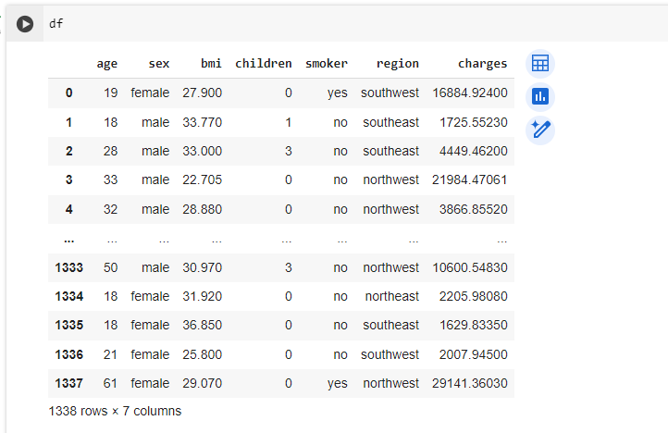
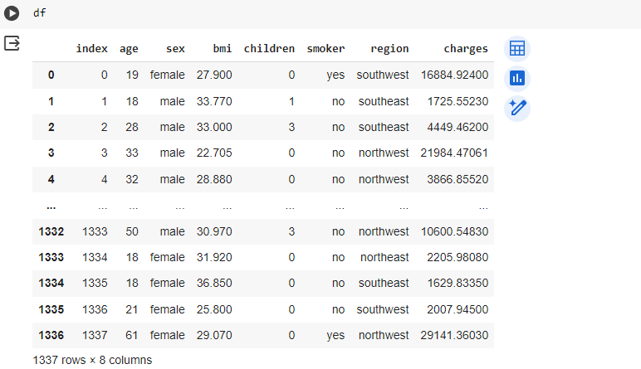
Data Cleaning Process

Slide 9
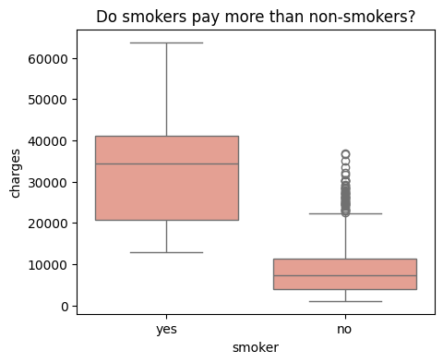
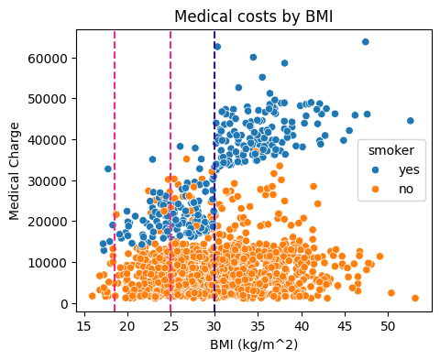
The image displays a box plot comparison between medical charges for smokers and non-smokers. The title “Do smokers pay more than non-smokers?” suggests an analysis of costs associated with smoking. The plot clearly shows that, on average, smokers incur higher charges than non-smokers. The box plots reveal the distribution of charges, with the median cost being higher for smokers.
The image is a scatter plot graph titled “Medical costs by BMI,” showing the correlation between Body Mass Index (BMI) and medical charges. Data points are color-coded to distinguish between smokers and non-smokers, with a noticeable trend of higher medical costs for smokers, especially those with higher BMI.

Slide 10
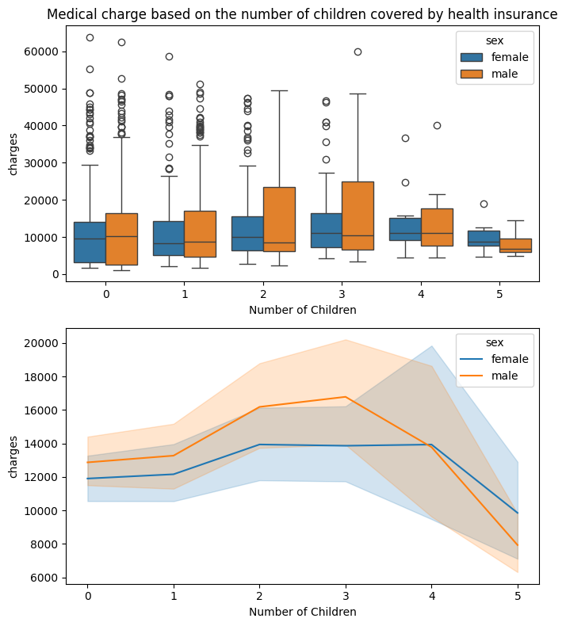
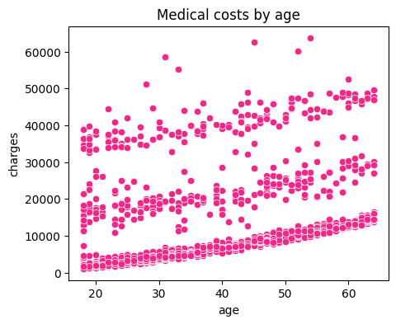

Slide 11
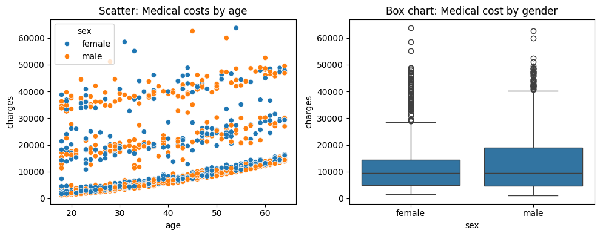
The image displays two graphs: a scatter plot showing medical costs by age and gender, and a box chart comparing medical costs by gender. In the scatter plot, there is a noticeable trend of increasing medical costs with age. The box chart illustrates a similar median cost for both genders but with different variations.

Slide 12
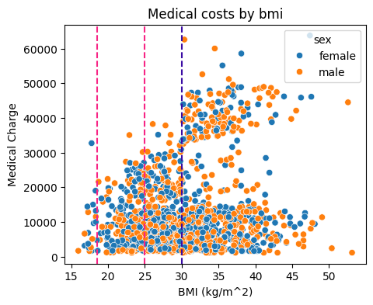
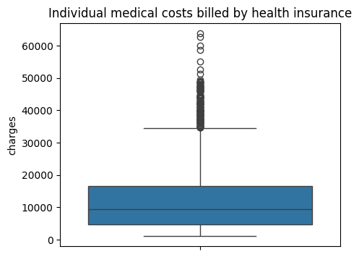
The image displays a box plot graph representing individual medical costs billed by health insurance. The y-axis is labeled “charges” and ranges from 0 to 60,000. The box plot shows a concentration of data points between 10,000 and 20,000 with outliers extending up to around 60,000. This visualization provides insights into the distribution and variability of medical charges within the dataset.
The image displays a box plot graph representing individual medical costs billed by health insurance. The y-axis is labeled “charges” and ranges from 0 to 60,000. The box plot shows a concentration of data points between 10,000 and 20,000 with outliers extending up to around 60,000. This visualization provides insights into the distribution and variability of medical charges within the dataset.

Slide 13
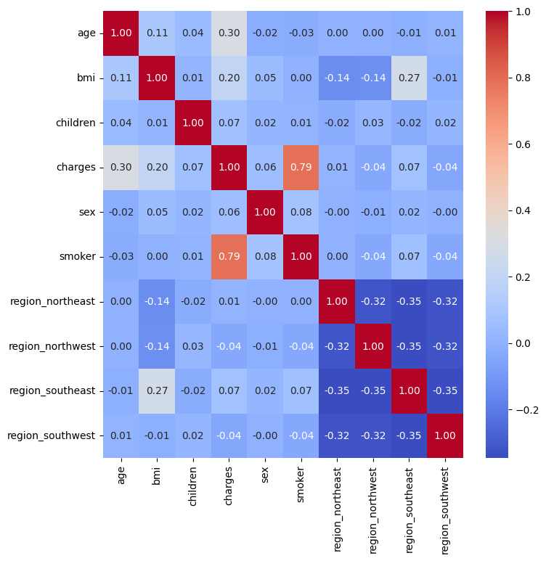
A correlation matrix heatmap, visualizing the relationships between different variables such as age, BMI, children, charges, sex, smoker status, and regions. The color gradient from red to blue indicates the strength and direction of correlations. Notably, there is a strong positive correlation between being a smoker and higher medical charges (coefficient of 0.79). Additionally, age and BMI show a weak positive correlation (coefficient of 0.11). The heatmap provides valuable insights for understanding how these factors impact medical costs.

Slide 14
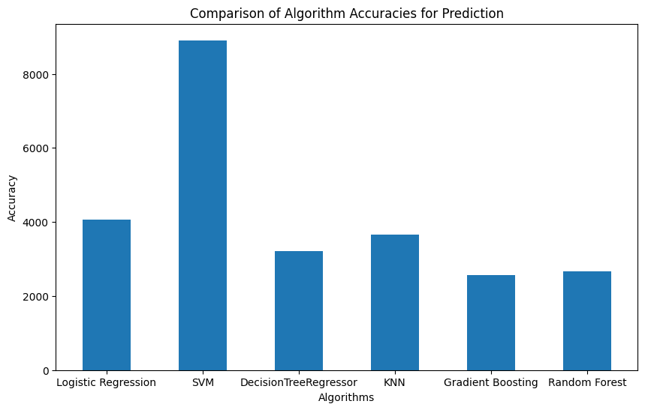

Slide 15
Conclusion
In conclusion, the models were evaluated based on Mean Absolute Error (MAE), which measures the average absolute difference between predicted and actual values. Among the models tested, GradientBoostingRegressor performed the best with the lowest MAE of 3977.77, followed closely by Random Forest Regressor with an MAE of 4015.65. Linear Regression and SVR showed higher MAE values, indicating less accurate predictions compared to other models. Decision Tree Regressor and AdaBoost Regressor also exhibited relatively higher MAE values, suggesting room for improvement in their predictive performance.

Slide 16


Slide 17

THANK YOU

